Slide 1
Data Driven Sales efficiency strategies and Business insights for the Retail Business
By ABDUL SHABEER AHMED
Data Analyst At Elevate Labs

Slide 2
TODAY’S AGENDA
Introduction
Key Performance Indicators (KPIs) Overview
Yearly Sales and Profit Trends
Top Performing Customers
Product Line Profitability
Geographical Performance
Business Insights & Strategic Recommendations

Slide 3
Objective of the Dashboard
To provide a comprehensive view of sales performance by tracking key metrics such as total sales, profit, quantity sold, and customer and product-level insights. The dashboard helps identify trends, assess profitability, and support data-driven decision-making for sales strategy and growth.
Scope of Analysis
Time period: 2003 to 2005
Data Coverage:
Sales transactions and orders
Product lines and categories
Customer segmentation and performance
Regional/state-wise sales data

Slide 4
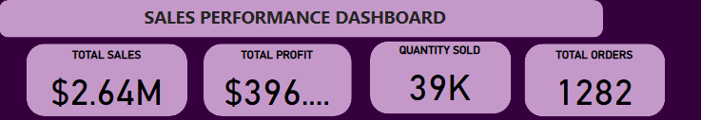
Key Performance Indicators (KPIs) Overview
Overall Performance (KPIs)
Total Sales: $2.64M
Total Profit: ~$396K
Quantity Sold: 39K units
Total Orders: 1,282
Insight:
The profit margin is relatively low (~15%), indicating potential pricing or cost optimization opportunities.
High quantity sold but low profit implies some product lines might have low profitability.

Slide 5
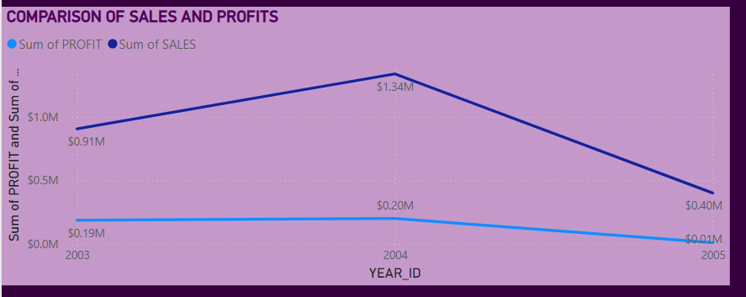
Yearly Sales and Profit Trends
Sales and Profit Trend (2003–2005)
2003: $0.91M Sales / $0.19M Profit
2004: Peak year with $1.34M Sales / $0.20M Profit
2005: Drop to $0.40M Sales / $0.04M Profit
Insight:
Sharp decline in both sales and profit in 2005 – requires investigation (e.g., market conditions, operational changes, product issues).
Despite increased sales in 2004, profit did not rise proportionally – suggests increased costs or discounted sales.

Slide 6
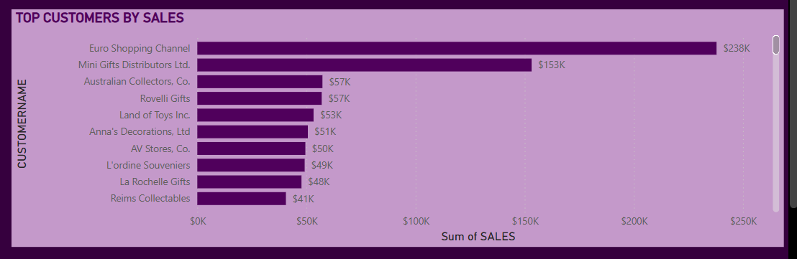
Top Performing Customers
Top Customers by Sales
Top 3 Customers:
Euro Shopping Channel: $238K
Mini Gifts Distributors Ltd.: $153K
Australian Collectors, Co.: $57K
Insight:
Sales are heavily concentrated among a few top customers – dependency risk if any major customer is lost.
Opportunity to grow lower-tier customers with targeted marketing or loyalty programs.

Slide 7
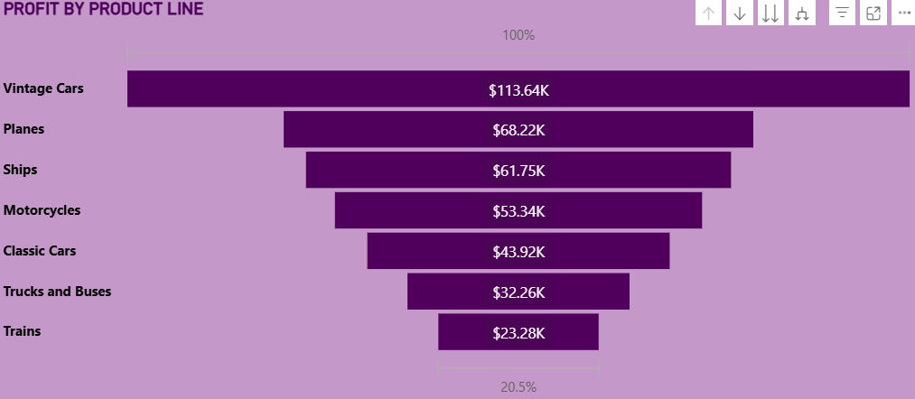
Product Line Profitability
Profit by Product Line
Most Profitable:
Vintage Cars: $113.64K
Planes: $68.22K
Ships: $61.75K
Least Profitable:
Trains: $23.28K
Trucks and Buses: $32.26K
🔹 Insight:
Vintage Cars dominate in profitability — likely a premium or high-volume product.
Products like Trains and Trucks underperform in profit despite their costs.

Slide 8
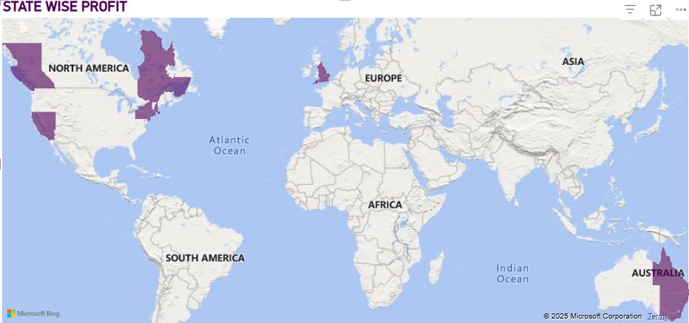
Geographical Performance
Geographical Performance (State-wise Profit)
High performing regions:
North America
Western Europe
Australia
🔹 Insight:
Strong presence in developed markets.
Minimal or no visible presence in South America, Africa, and parts of Asia.

Slide 9
Strategic Recommendations based on the Business Insights
RECOMMENDATION:
Invest in customer retention programs for top clients.
Expand customer base by targeting new and mid-level clients with personalized offers. Conduct a root cause analysis for the 2005 decline and introduce contingency plans or strategic pivots based on findings.
Increase marketing & supply for high-profit product lines (e.g., Vintage Cars).
Reassess and possibly redesign or discontinue low-profit product lines unless they serve a strategic purpose.
Market expansion into emerging economies through tailored product offerings and pricing models.
Perform deep-dive reports by deal size to optimize the sales pipeline.
Work on resolving high-frequency issues related to disputed or on-hold orders.

Slide 10
AREA | RECOMMENDATION
Sales Drop (2005) | Investigate root cause and mitigate loss
Top Customers | Strengthen key account relationships, reduce dependency
Product Strategy | Focus on profitable products (Vintage Cars), drop or revamp low-margin ones
Market Expansion | Target untapped regions (Asia, Africa) with tailored strategies
Order Optimization | Analyze and fix order bottlenecks using deal size and status filters
Profitability | Explore cost-cutting and better pricing to increase margins

Slide 11
Thank you!

